Slide 1


Blood Pressure Monitoring System Using Machine Learning
Project members: Lhaden (02190119) Phurpa Wangmo(02190123) Nima Dorji Tamang(02180310) Darshan Subedi(02190108) Project guide: Dr. Kazuhiro Muramatsu
Co-Guide: Mr. Duk Bahadur Powdyel

Slide 2
Overview
Problem statement
Aims and Objectives
Methodology and Flow Chart
Data Analysis and Preprocessing
Model Training
Future Work
Work plan

Slide 3
Problem Statement
Traditional BP monitoring systems are only capable of providing an instantaneous reading and do not provide any analysis.

Slide 4
Aim: Blood Pressure monitoring system capable of classifying data using machine learning model.
Objectives:
Create an interface that reads blood pressure data in real time.
Set up a database that is capable of storing and processing(visualizing) data.
Training a machine learning model that is able to classify blood pressure related medical conditions based on the given set of data.
Create a webserver to integrate the above systems and display the data on a web page.

Slide 5
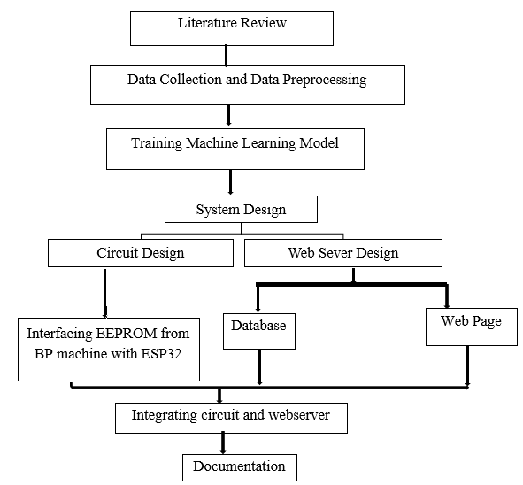
Methodology

Slide 6
Flow Chart
Start
Data Collection
Data Analysis
Yes
Is data valid?
Model selection
Preprocessing
Model Training and Testing
No
Good Accuracy?
No
Yes
End

Slide 7
Resource
Training the ML model
Platform: Google collab.
Dataset: From Kaggle

Slide 8
Features of Dataset
Age (days)
Height (cm)
Weight (kg)
Gender (1= Female & 2= Male)
Systolic blood pressure ( ap_hi )
Diastolic blood pressure (ap_lo)
Cholesterol ( 1: normal, 2: above normal, 3: well above normal )
Glucose (1: normal, 2: above normal, 3: well above normal )
Smoking ( binary )
Alcohol intake ( binary )
Physical activity ( binary )
Presence or absence of cardiovascular disease ( binary)

Slide 9
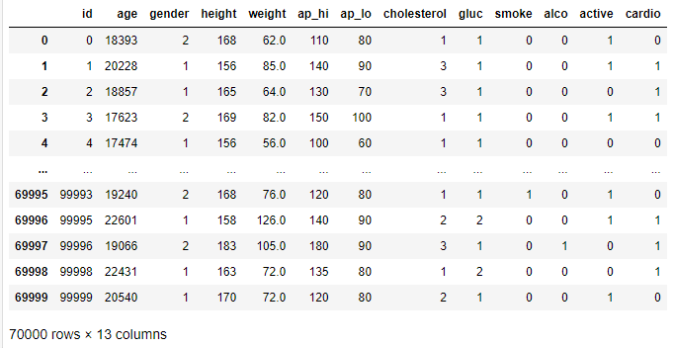
Dataset in .csv

Slide 10
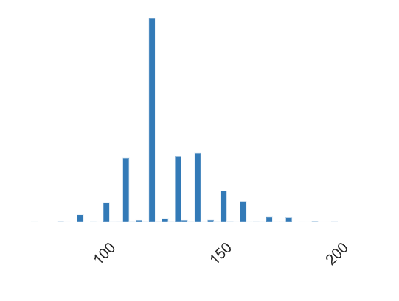
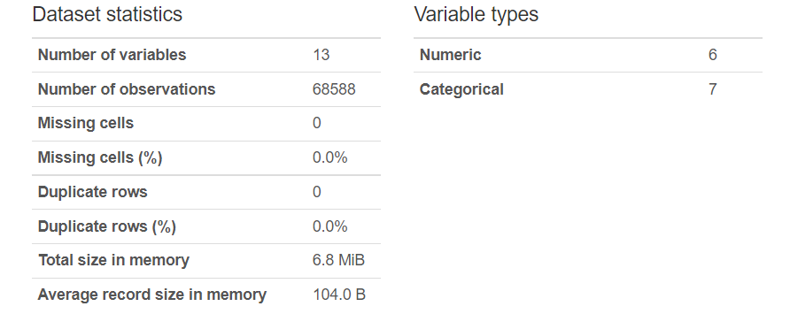
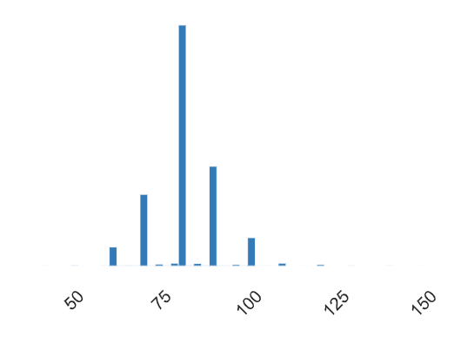
Data Analysis
Systolic Distribution
Diastolic Distribution

Slide 11
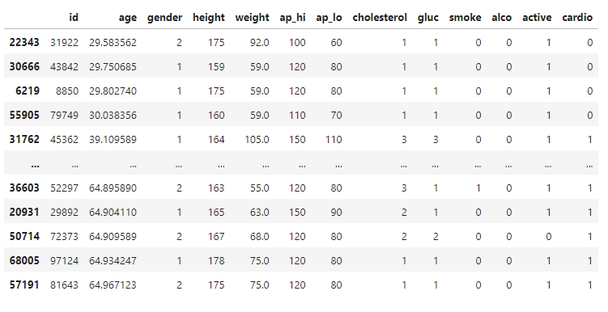
Preprocessing Data
Age : Sorting the age range

Slide 12
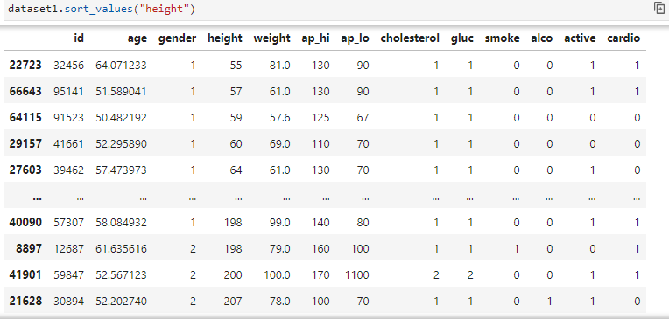
Height
Sorting height to check validity
Filtering of unrealistic height [100cm to 200cm]

Slide 13
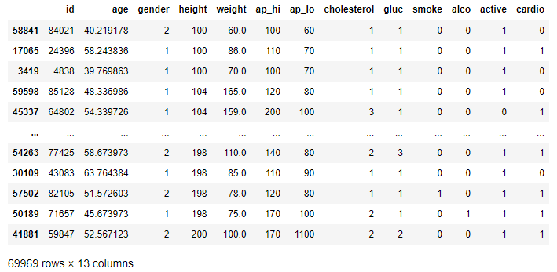
Save and update the new data set

Slide 14
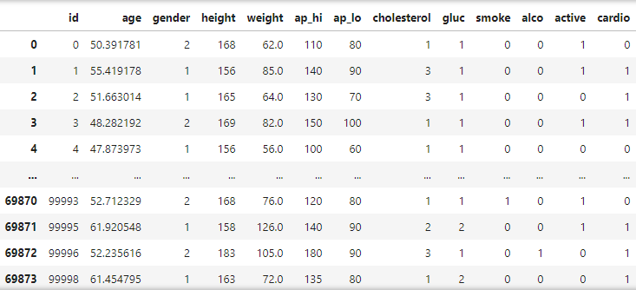
Weight
Sort the weight to check validity
Range 40Kg to 110Kg
Save and update the new dataset

Slide 15
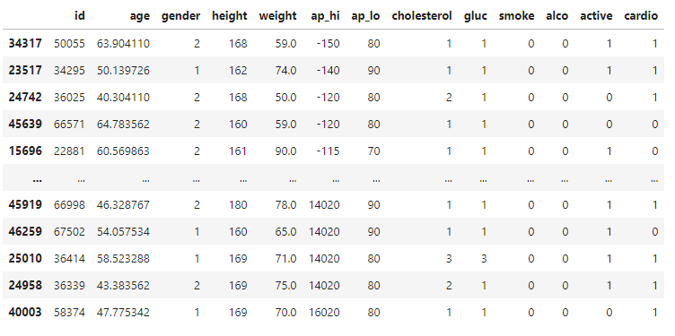
Systolic Pressure
Sorting ap_hi (systolic pressure) to check validity
Range 40mmHg-200mmHg
Save and update the new dataset

Slide 16
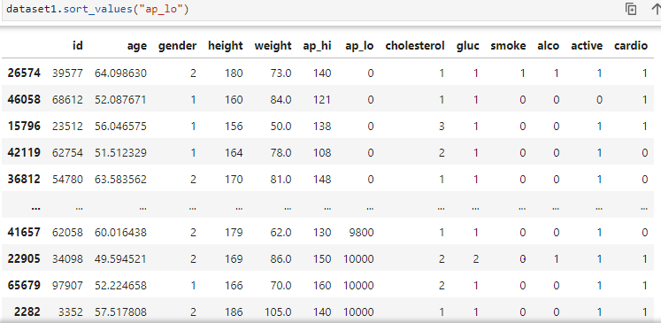
Diastolic Pressure
Sorting ap_lo (diastolic pressure) to check validity
Range 40mmHg to 150mmHg
Save and update the new dataset

Slide 17
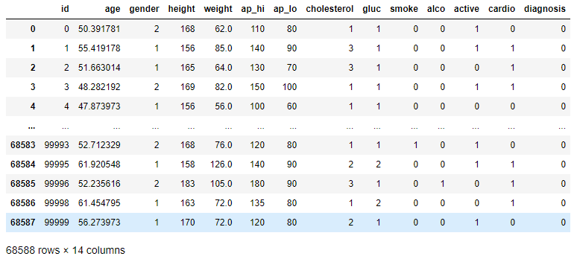
Classification and labelling

Slide 18
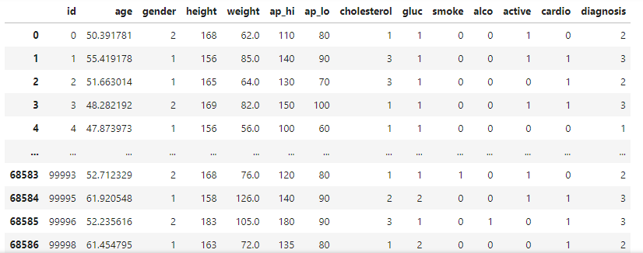
1= Hypotension
2 = Normal
3 =Hypertension

Slide 19
Model selection
How did we select the model?
Based on our Dataset
Why did we chose these model?
Regression is used to find the relationship between two variables
Model Selected:
Multiple linear Regression
Multinomial Logistic Regression

Slide 20
Model Training
Splitting the data into X and Y variable where X is independent and y is dependent.
Train Test split
Dataset 68588
Data Training: 54870(80%)
Data Testing: 13718(20%)

Slide 21
1. Multiple linear Regression
To estimate how strongly two or more independent variables influence the single dependent variable.
To find the values of dependent variables at a definite condition of the independent variables.

Slide 22
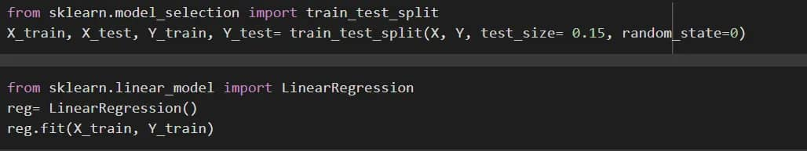
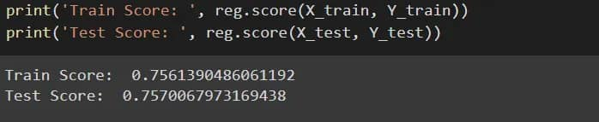
Code snippet

Slide 23
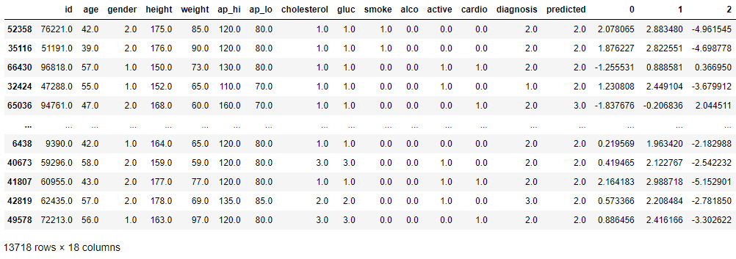
2. Multinomial Logistic Regression
To predict a categorical dependent variable based on values of independent variables.
It extends the logistic regression algorithm to solve multiclass possible outcome problems, given one or more independent variables.
1
2
3
Data Training Accuracy =92.8%
Data Testing Accuracy = 93.1%

Slide 24
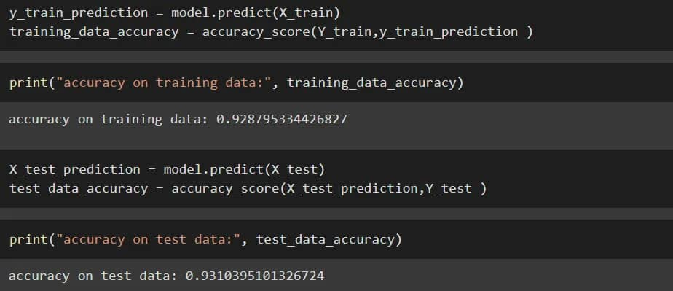
Multinomial Logistic Regression

Slide 25
Conclusion
Comparing the two models namely, Multinomial logistic Regression and Multiple linear Regression, we conclude that Multinomial logistic Regression has better test set accuracy of 93.1% in comparison to Multiple linear Regression with 75.7%.

Slide 26
Future work
Transfer the data to ESP32 from the EEPROM
Set up a database that is capable of storing and processing(visualizing) data from BP monitor
Create a webserver to integrate the systems and display the data on a web page.

Slide 27
Reference
Tensor flow:
Retrieved from:
https://www.tensorflow.org/?gclid=EAIaIQobChMIhLmIxazq-gIVVSUrCh1JSgYEEAAYASAAEgLPyPD_BwE
Sci kit learn:
Retrieved from:
https://www.bing.com/ck/a?!&&p=a65bbc2ece40f116JmltdHM9MTY2NjA1MTIwMCZpZ3VpZD0xNTJjZ TM4Mi01MDI1LTY2ODAtMTI0My1mMWMzNTEyNDY3NGQmaW5zaWQ9NTE3Mg&ptn=3&hsh=3&fcli d=152ce382-5025-6680-1243-f1c35124674d&psq=scikit- learn&u=a1aHR0cHM6Ly9zY2lraXQtbGVhcm4ub3JnL3N0YWJsZS9pbmRleC5odG1s&ntb=1

Slide 28
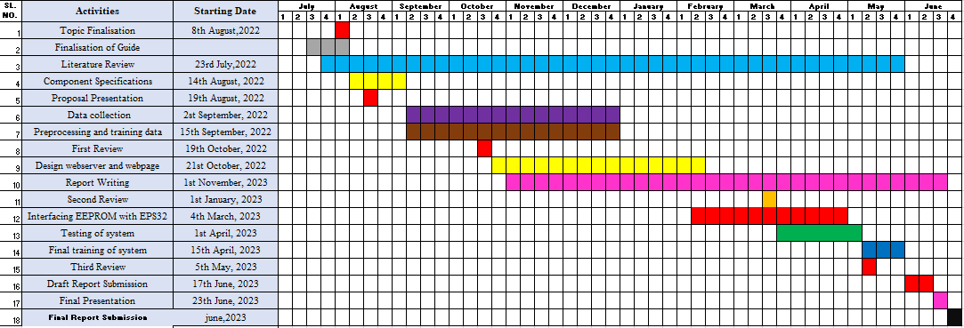
Work Plan

